Slide 1
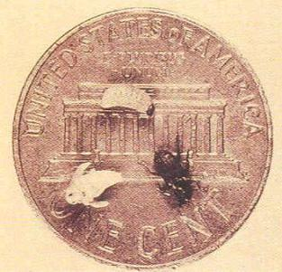
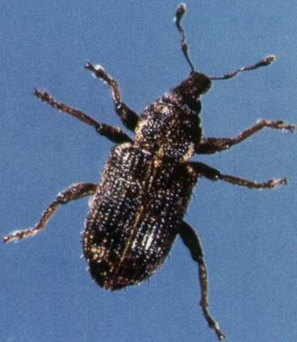
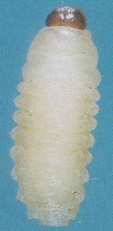
Biology and Management of the
Annual Bluegrass Weevil
Albrecht Koppenhöfer
Rutgers Cooperative Extension
Updated 1-14-2025

Slide 2
ABW Biology and Control
Biology, ecology, damage (3-24)
Monitoring (25-41)
Insecticide resistance (42-79)
Sustainable management:
non-resistant (80-97)
Sustainable management: resistant (98-106)
Biorationals (107-124)
Turning ABW into an ally (125-127)

Slide 3
ABW Biology and Control
Biology, ecology, damage
Monitoring
Insecticide resistance
Sustainable management: non-resistant
Sustainable management: resistant
Biorationals
Turning ABW into an ally

Slide 4
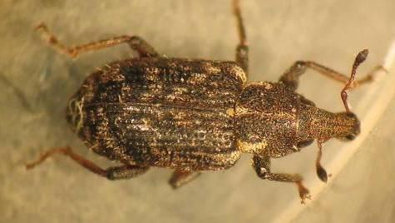
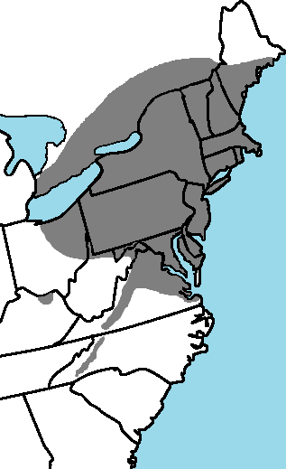
ABW
B. McGraw
Serious expanding pest of close-cut annual bluegrass
Serious problems through-out NJ, NY, CT, PA, RI, MA, NH, VT, DE, MD.
Also problems in parts of KY, OH, ME, NC, VA, ONT, QUE.
Notes:
4

Slide 5
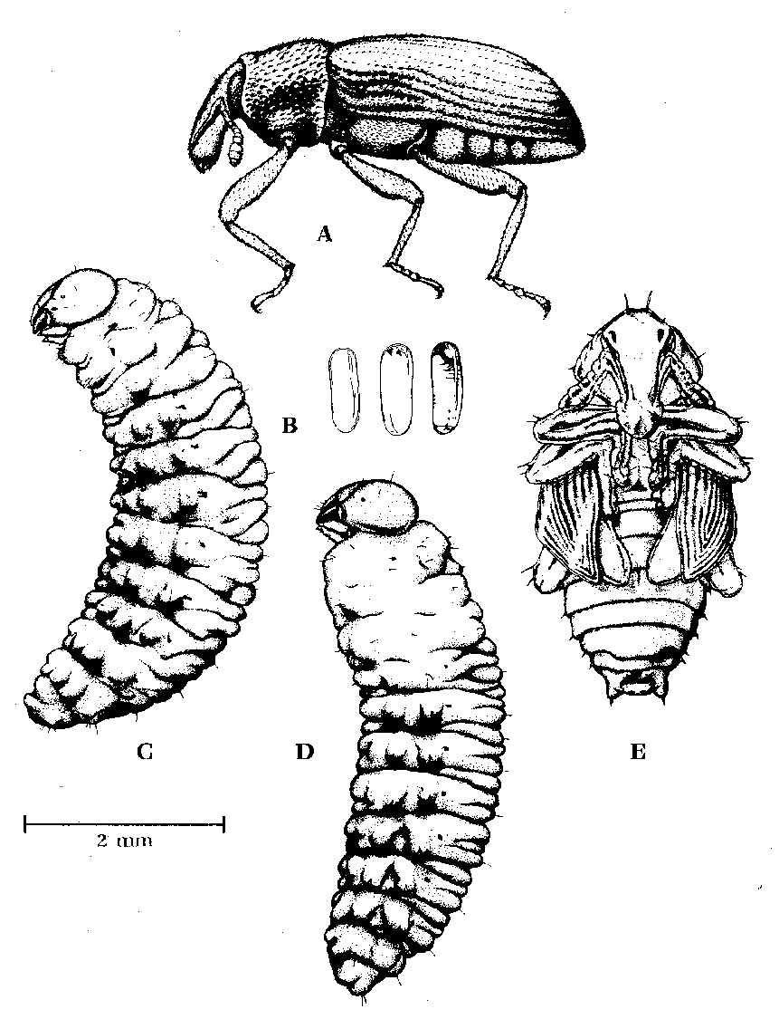
ABW Morphology
Adult
Eggs
Larva (5th)
Pupa
0.08”
from Cameron & Johnson 1971
R. Cameron
Prepupa

Slide 6
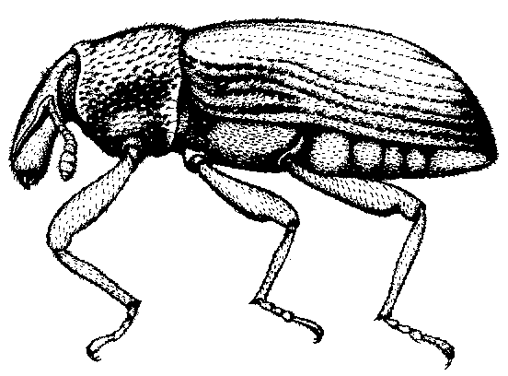
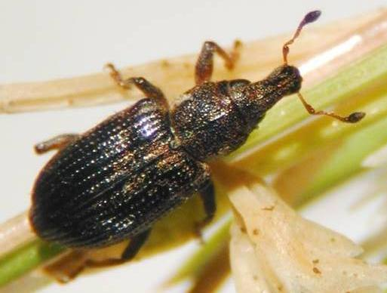
ABW
Adult
Short, blunt snout with mouthparts at tip
Elbowed antennae attached near snout tip
Length of snout+head+thorax < elytra
Body dark charcoal-gray, covered with fine yellowish hair and scales that wear off with age
1/8” – 5/32” long
R. Cowles
from Cameron & Johnson 1971

Slide 7
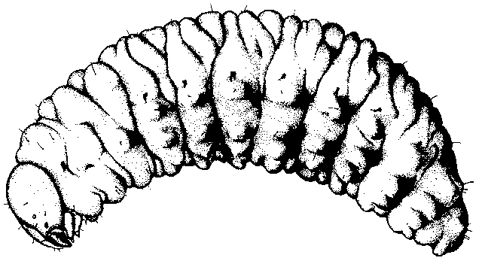
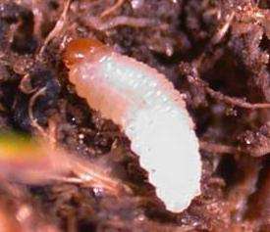
ABW
Larva
Cream colored body, brown head
Body somewhat curved, pointed at tail, legless
0.03 (L1) to 0.2” (L5) long
from Cameron & Johnson 1971
R. Cowles

Slide 8
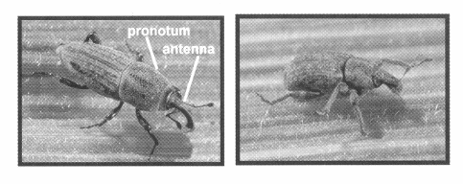
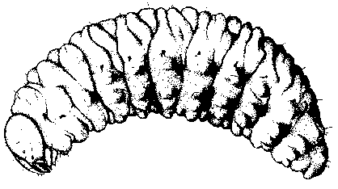
Annual
Bluegrass
Weevil
Billbug

Slide 9
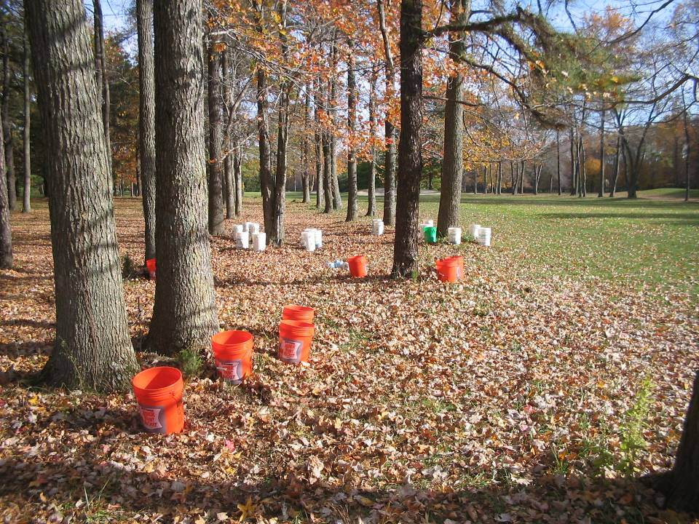
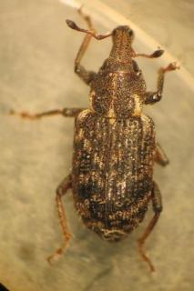
Adult Overwintering
Adult extraction by submersion of substrate samples in warm water
Adults overwinter in the top 1-2”of soil/turf profile, under taller grass, under tree litter, around trees, even in roughs
B. McGraw

Slide 10
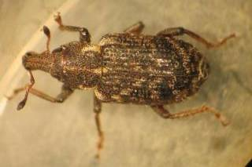
Adult Overwintering
Overwinter up to 200’ from fairway and up to 30’ into the woods
Most abundant near tree lines and around trees in grass between fairways.
No beetles found within 15’ of fairway
Prefer tall grass and mixed leaf litter.
If under pine trees, only where grass starts to grow as soil too acidic directly under canopy.

Slide 11
Adult spring migration to playing surfaces
arrival spread out over several weeks because:
affected by variably spring temps
converging from different overwintering sites
more than 1 peak if cool temps interrupt migration
primarily on foot
Notes:
Changes to 2nd point

Slide 12
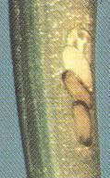
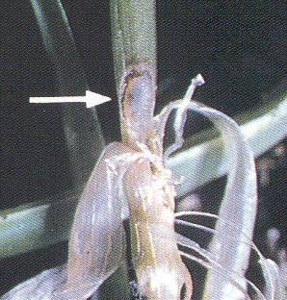
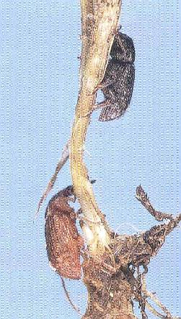
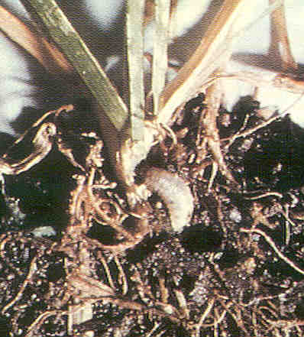
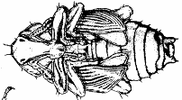
mature Adult
NYAES
Eggs laid
under sheath
larva (3rd) feeding inside stem
R. Cameron
ABW
Life Cycle
R. Cameron
immature Adult
NYAES
Pupation in soil
mature larva (5th) feeding on crown
Notes:
12

Slide 13
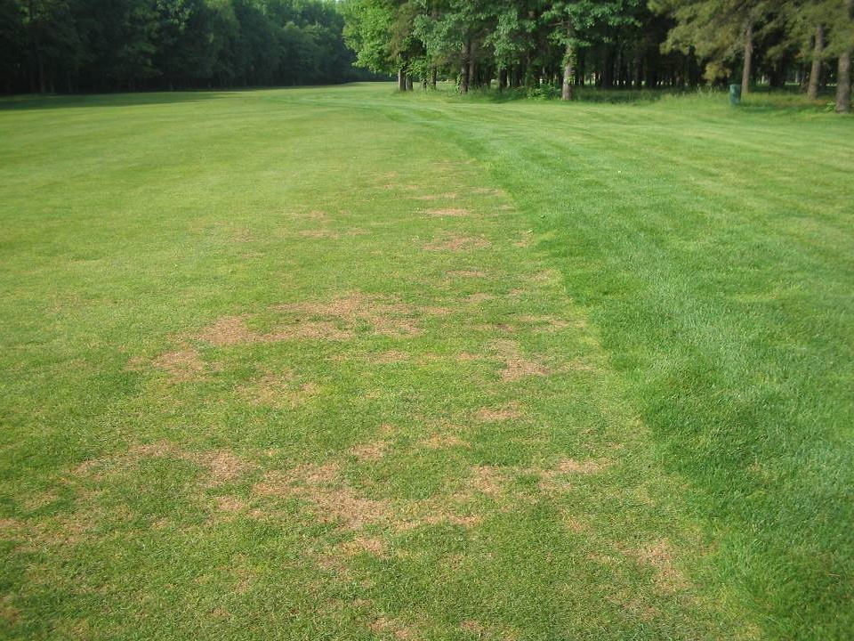
1st Signs of Larval Feeding Damage (late May)
Usually starts at edges of fairways, greens, tees.
Small, yellowish-brown spots
Scattered dead spots grow together.
Tunneled stems break off at crown.
B. McGraw

Slide 14
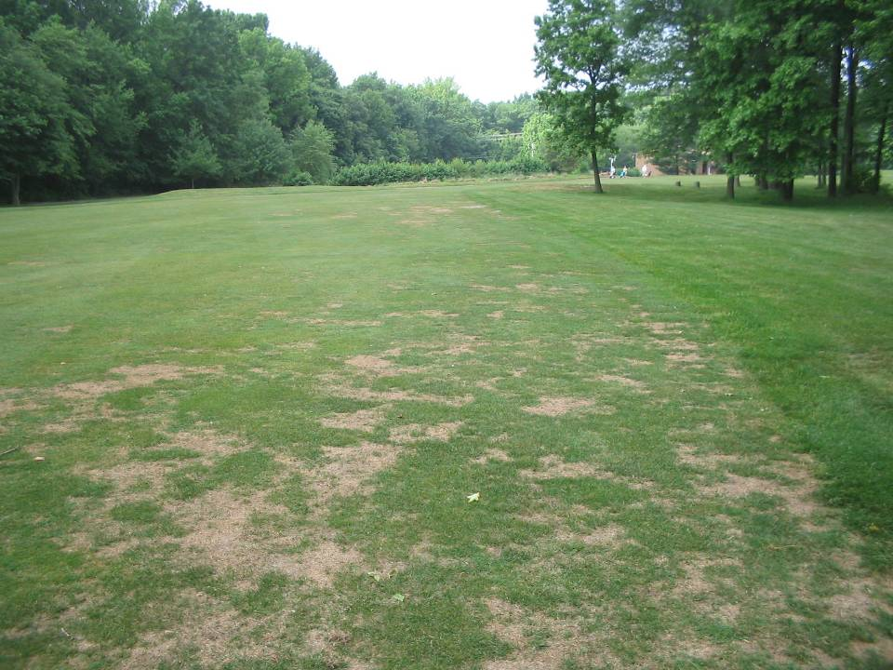
Extensive Larval Feeding Damage
Worst damage early to mid-June (1st gen.).
Usually less damage in late July/early August (2nd gen.).
B. McGraw

Slide 15
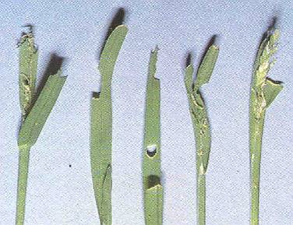
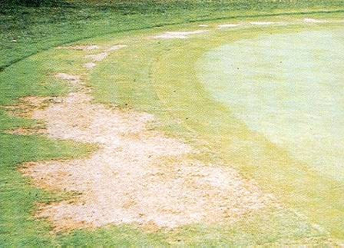
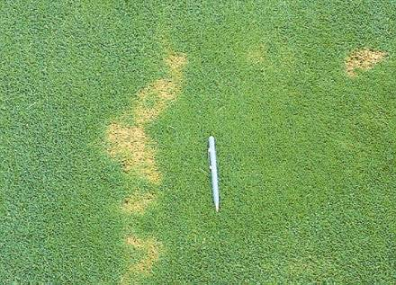
ABW
Injury
Early summer damage
along edge of fairway
NYAES
B. McGraw
Leaf notching by adults
Damaged Poa surrounded by undamaged bentgrass
Damage
to collar
R. Cameron
H. Tashiro

Slide 16
ABW Seasonal Life-cycle
(average timing for NY metropolitan area)
*L1-3 = 1st thru 3rd larval stage; L4-5 = 4th thru 5th larval stage
From: Koppenhöfer et al. 2012
Notes:
16

Slide 17
Host plant resistance for ABW management
Low cost
Highly compatible with other tactics
Long lasting
Environmentally sound
Host plant resistance components:
Tolerance: plant tolerates feeding better, but may support high pest density
Resistance: detrimental for pest development and reproduction → fewer/no pests

Slide 18
Host Plant Resistance to ABW
Severe damage typically in areas with high P. annua percentage
But damage to bentgrass possible
Limited previous experimental data suggest:
Same larval density in P. annua and CBG (Rothwell 2003)
No effect of host species on spring adult and larval distribution (McGraw & Koppenhöfer 2010)
Higher ABW tolerance of pure CBG vs. mixed stands of CBG + P. annua (McGraw & Koppenhöfer 2009)
Notes:
Deleted comma after last bullet – not a complete sentence

Slide 19
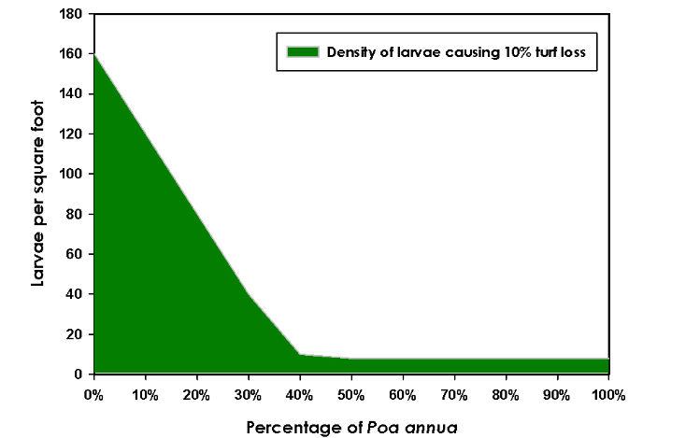
Larval density and damage in mixed Poa – creeping bentgrass stands
Data suggest, to cause damage it takes:
up to 160 larvae per ft² in
pure creeping bentgrass ….
… as few as 10 larvae per ft²
in pure Poa
McGraw & Koppenhöfer (2009)
Notes:
I find, and always have found gut feeling-wise, these values a bit extreme. Based on Olga’s greenhouse data, the 10/ft2 for Poa might be just a bit too low, but the 160 for creepers is clearly too high. Olga’s data suggest that it takes about 3-4 times as many in creepers as in Poa.

Slide 20
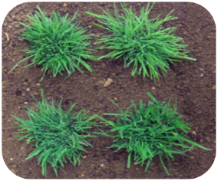
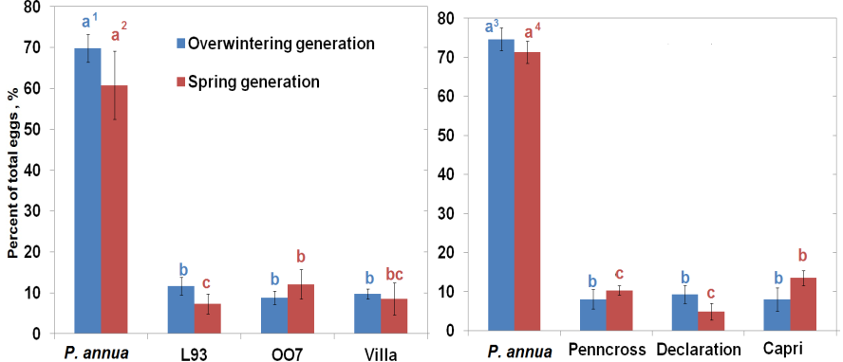
Egg-laying – 4-choice field arenas
10 females + 10 males for 1 wk
Creeping bents Velvet
Creeping bents Colonial
P. annua preferred for oviposition.
No clear differences among bentgrasses
Kostromytska &
Koppenhöfer (2014)
Notes:
Bottom to 20 pt

Slide 21
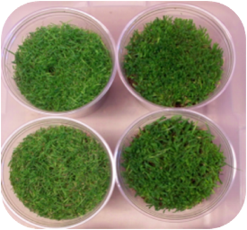
Egg-laying + Larval Development
No-choice greenhouse test
5 fem. + 5 males for 1 wk
→ Stages after 5 wk
2011
Creeping bents Colonials Velvets
More stages in P. annua than in bentgrasses
Creeping bentgrasses have the fewest larvae.
BUT: ABW fully develops in all bentgrasses
2012
Kostromytska & Koppenhöfer (2014)

Slide 22
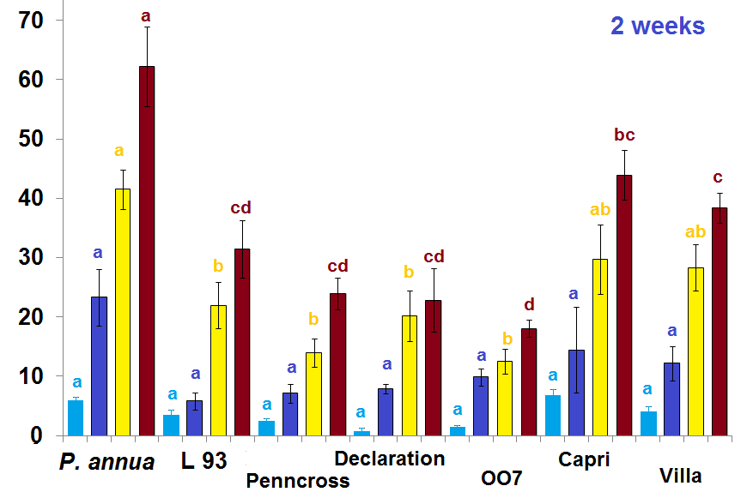
Tolerance to larval feeding - Greenhouse tests
3rd-4th instars introduced (0, 71, 142, 284 / ft²)
% damage
Kostromytska & Koppenhöfer (2016)
P. annua most susceptible
‘Capri’ (Colonial), ‘Villa’ (Velvet) most susceptible bentgrasses
No significant difference among creeping bentgrasses
Notes:
Rearrange to make graph as big as possible. Was just too small.

Slide 23
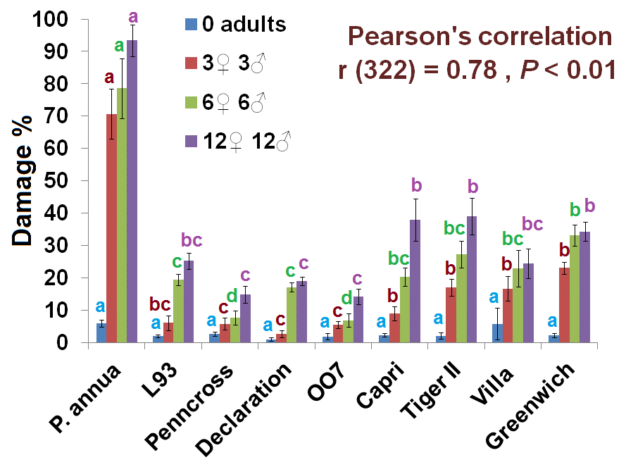
Effect of grass cultivar and adult density on grass damage by progeny larvae (greenhouse)
Creeping BG
Colonial BG
Velvet BG
Notes:
No title on y-axis

Slide 24
Host Plants – Summary:
Poa annua preferred for egg laying, better for larval development, and least tolerant grass.
Creeping bentgrasses can be damaged but much less likely, much less intensive, and can recover better.
→Best preventive control for ABW problems: Keep P. annua percentage as low as possible wherever possible using cultural practices, PGRs, and herbicides

Slide 25
ABW Biology and Control
Biology, ecology, damage
Monitoring
Insecticide resistance
Sustainable management: non-resistant
Sustainable management: resistant
Biorationals
Turning ABW into an ally

Slide 26
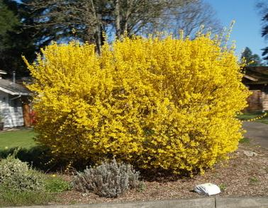
Plant Phenology for ABW
Forsythia full bloom → overwintering adults become active
Migration from overwintering sites to playing surfaces has started.
Adult densities on playing surfaces increase during full bloom.
Notes:
26

Slide 27
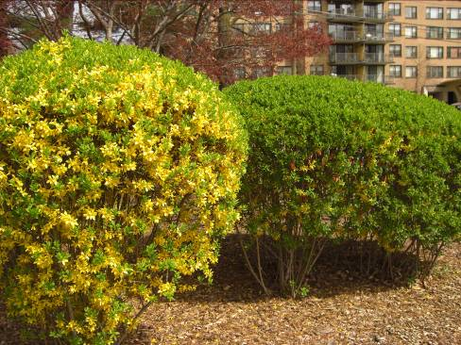
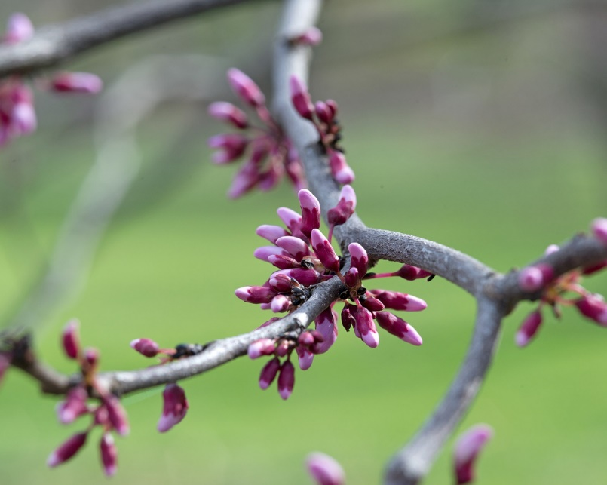
Plant Phenology for ABW
Forsythia ½ gold : ½ green
Eastern redbud early bloom
→ peak adult densities on playing surfaces
→ best time to spray vs. overwintered adults
But: blooming variable → Don’t rely on just 1 or 2 plants.
B. McGraw
Notes:
27

Slide 28
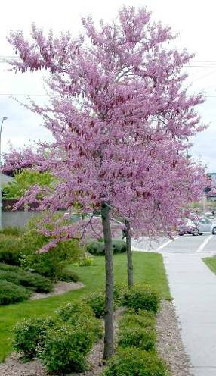
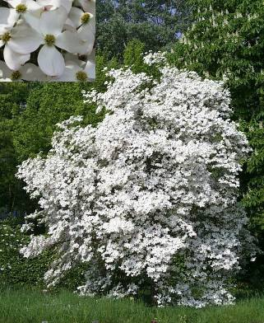
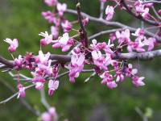
Plant Phenology for ABW
Flowering dogwood full bloom
Eastern redbud full bloom
→ egg-laying has begun
→ adulticides become ineffective
Notes:
28

Slide 29
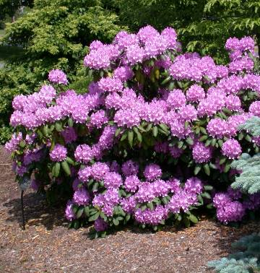
Plant Phenology for ABW
Catawba Rhododendron hybrid full bloom
→ larvae start appearing in soil
→ curative larvicides.
R. Cowles
Notes:
29

Slide 30
Phenological Indicator Plants for ABW
(average timing for NY metropolitan area)
*L1-3 = 1st thru 3rd larval stage; L4-5 = 4th thru 5th larval stage
From: Koppenhöfer et al. 2012
Notes:
30

Slide 31
Degree-Day Models
Predict insect activities and fine-tune treatment timing.
Baseline developmental temperature for most insects 50°F.
Calculate degree-day (GDD) units for each day:
(min.temp. + max.temp.) - baseline temp
2
Add up average GDD units for each day → GDD accumulation
No values < 0!

Slide 32
Degree-Day Accumulation
(base 50 = GDD₅₀)
Date | Max Temp | Min Temp | Total | Ave | Minus 50 for baseline | DD Accumu- lation
4/13 | 58 | 40 | 98 | 49 | 0 | 0
4/14 | 66 | 42 | 108 | 54 | 4 | 4
4/15 | 70 | 46 | 116 | 58 | 8 | 12
4/16 | 75 | 49 | 124 | 62 | 12 | 24
4/17 | 71 | 47 | 118 | 59 | 9 | 33

Slide 33
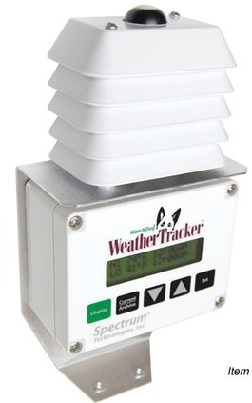
Degree-Day Recording
For best regular updates:
-Use own weather station data to
calculate GDDs.
-Use weather/GDD trackers,
ideally more than 1 per GC.

Slide 34
Observation | GDD₅₀ | GDD₅₀ Range
Forsythia full bloom | 46 | 23−69
Forsythia 50:50 | 158 | 113−210
Dogwood full bloom | 188 | 139−280
L1.5 | 298 | 265−291
L2.0 | 331 | 264−338
Rhodo full bloom | 389 | 306−444
L2.5 | 396 | 390−425
L3.0 | 486 | 413−560
L3.5 | 540 | 409−553
L4.0 | 636 | 618−746
Degree-Day Correlations for NJ
L_{avg} = [nL₁×1 + nL₂×2 + nL₃×3 + nL₄×4 + nL₅×5 + nPu×6 + nTA×7]/N

Slide 35
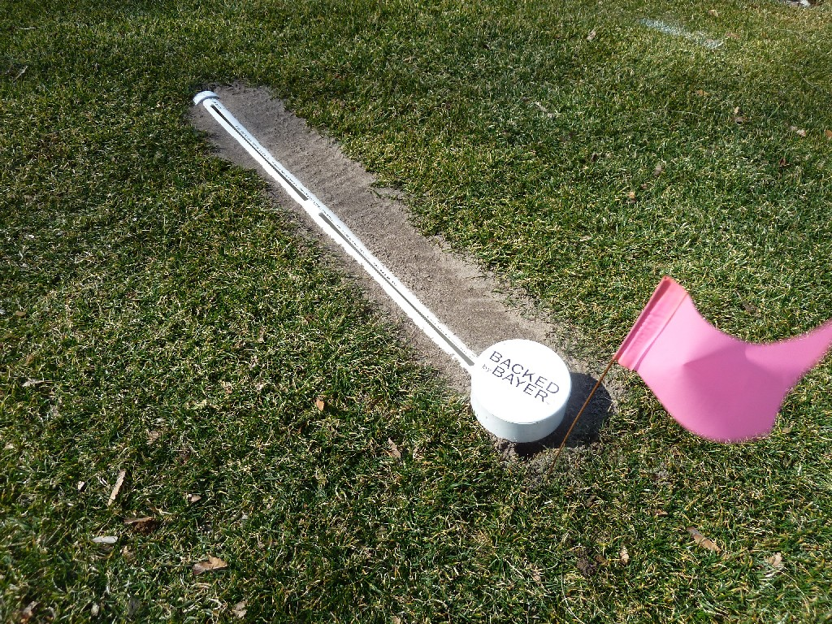
Linear Pitfall Traps to monitor adult movement (not good estimate of adult densities)
D. Pease
B. McGraw
Notes:
Don’t you have also a pic of a trap sunken in the turf?

Slide 36
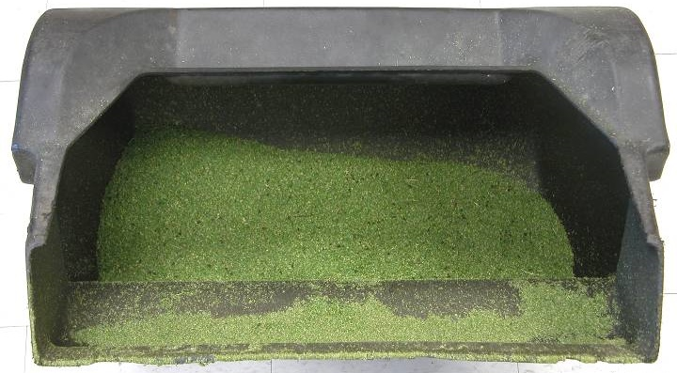
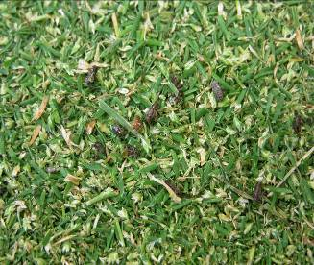
Monitoring Adults - Grass clippings
Many adults picked up by mowers
Extraction: ~15% on green but < 1% on fairways
Adult numbers in standard samples should be correlated to population built-up
BEWARE: 70% of adults survive mowing undamaged → discard clippings with significant adult numbers away from playing surfaces.
S. Tirpak
Notes:
36

Slide 37
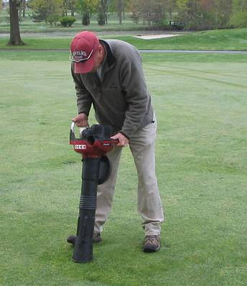
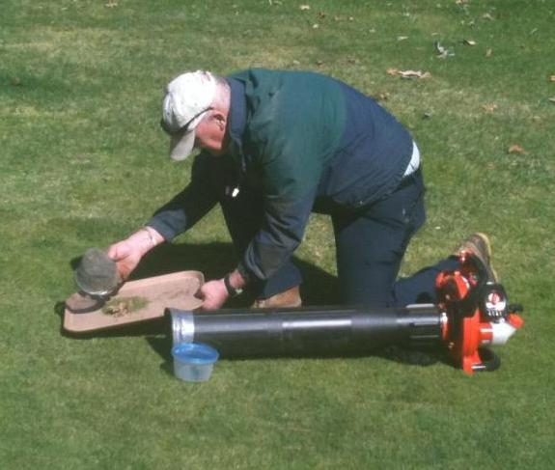
Monitoring Adults
Vacuuming
Inverted leaf blower to suck adults into an inserted sieve basket
Between Forsythia full bloom and ½ gold : ½ green
Extraction: ~30% on green, ~5% on fairways
number of adults sucked up indicator of ensuing larval populations
B. McGraw
B. McGraw
Notes:
37

Slide 38
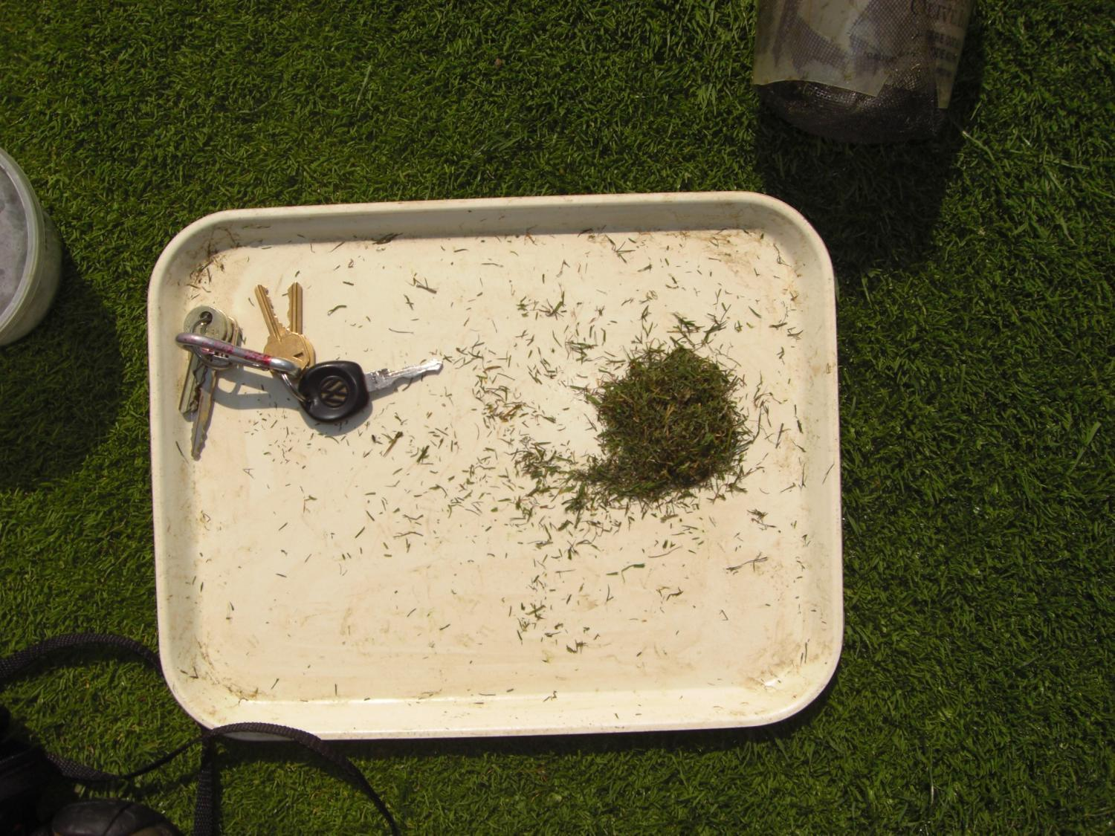
Vacuum sampling adults : Standardize your sampling plan (1-2x/week) → count ABW and chart numbers
What I do:
5 vac samples (20 sec. ea) from 5 collars 1x per week at 11 am
= 40 MINS
B. McGraw
Notes:
… /week just to make it clearer to everybody
5 samples from each collar?

Slide 39
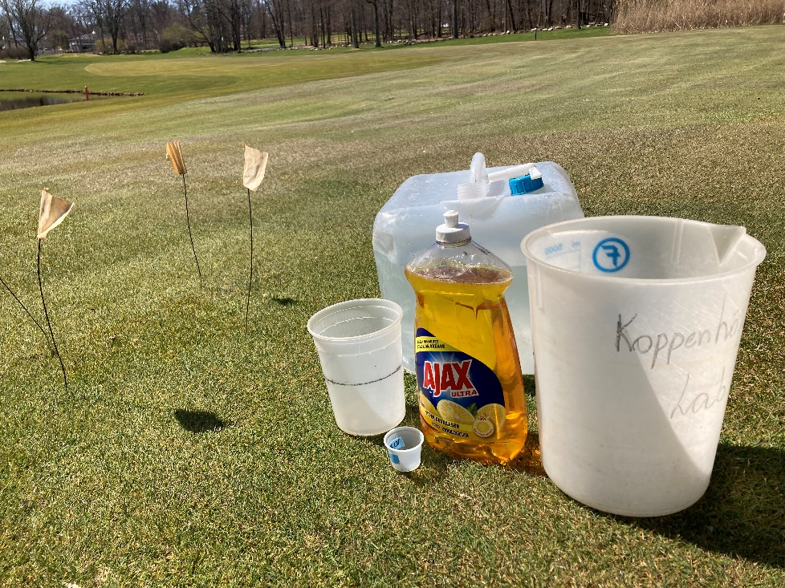
Monitoring Adults -Irritant Solutions
0.75 fl oz. lemon scented liquid dishwashing detergent per gal of water (0.6%)
Spread 1 pt (~500 ml) solution per 1’x1’ area and repeat after 5 min
Irritates adults to surface onto grass blades
Collect after 5, 10, 15 (20) min (~80% extracted)
Multiple samples per area
Most precise and consistent method
BUT: Irrigate afterwards to avoid SCALD!!!

Slide 40
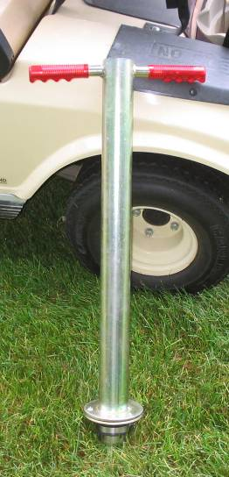
Monitoring – All Stages
In spring, start with Rhododendron full bloom
Cut turf cores with turf plugger (2.3” diam) or knife (1-2” deep).
Break up soil and thatch on a tray and count insects.
For more detail: Submerge material in lukewarm water → remaining pupae, larvae, adults float up in 5-10 min.
Adequately irrigated turf can tolerate 30-50 larvae/ft²
B. McGraw
Notes:
40

Slide 41
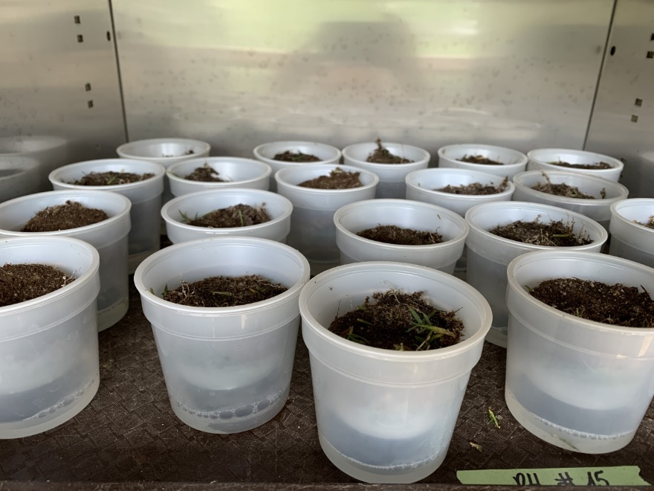
Monitoring all Stages more precisely
Salt extraction:
Break 2.5” diam cores into 3-4 pieces
Submerge cores in lukewarm water saturated w/ salt for 1 hr.
Stir after 1, 20, and 40 min.
Collect & count floating stages
Heat extraction in Berlese traps:
Heat (90–100°F) for ~ 4 days
Very efficient, but not very practical
Notes:
You gotta get the samples some how!

Slide 42
ABW Biology and Control
Biology, ecology, damage
Monitoring
Insecticide resistance
Sustainable management: non-resistant
Sustainable management: resistant
Biorationals
Turning ABW into an ally

Slide 43
ABW Resistance to Insecticides
Many GCs apply >3 treatments per season, up to 10 per season !!!
→ suggests resistance to insecticides.
Many resistant populations detected !
Likely that most GCs with > 5 years of intensive insecticide use vs. ABW have some level of resistance!
Notes:
43

Slide 44
ABW Survey 12/2014–2/2015
Region | No. of responses | ABW applic. / year |  |  | Resistance suspected (%)
 |  | Avg. | > 5 (%) | > 9 (%)
All Regions | 291 | 3.9 | 18 | 6 | 19
North.Periph. | 13 | 2.2 | 0 | 0 | 0
MA | 33 | 4.4 | 13 | 10 | 0
CT | 25 | 4.2 | 20 | 12 | 48
NY | 56 | 4.1 | 18 | 14 | 29
LI | 20 | 5.5 | 30 | 20 | 55
Upstate | 26 | 2.3 | 0 | 0 | 8
NJ | 32 | 4.4 | 23 | 0 | 28
PA | 74 | 4.2 | 24 | 1 | 22
DE-MD-VA | 42 | 3.6 | 17 | 0 | 5
South.Periph. | 16 | 2.9 | 0 | 0 | 0
(McGraw & Koppenhöfer 2017)
Notes:
44

Slide 45
Resistance to Insecticides
Resistance result of artificial selection pressure in favor of genes that convey ability to survive toxin exposure
Genes controlling resistance mechanisms already present before exposure in 0.01–1% of population
In resistant populations, frequency of resistance genes up to 97%.

Slide 46
Model assuming simple genetics of Resistance
S = original gene version → susceptible
R = mutated gene version → resistant
Insects have 2 copies of each gene that controls a resistance mechanism
→ SS = individual fully susceptible
RR = individual fully resistant
RS = intermediate resistance level
Notes:
Took out last 2 bullets. Not important.

Slide 47
Simple Model of Resistance Development
1st Generation: before application
SS
RS
RR
Insecticide efficacy:
SS = 90%; RS = 60%; RR = 0%

Slide 48
Simple Model of Resistance Development
1st Generation: after application
SS
RS
RR
→ 89% control
Insecticide efficacy:
SS = 90%; RS = 60%; RR = 0%

Slide 49
Simple Model of Resistance Development
2nd Generation: before application
SS
RS
RR
Insecticide efficacy:
SS = 90%; RS = 60%; RR = 0%

Slide 50
Simple Model of Resistance Development
2nd Generation: after application
SS
RS
RR
→ 86% control
Insecticide efficacy:
SS = 90%; RS = 60%; RR = 0%

Slide 51
Simple Model of Resistance Development
3rd Generation: before application
SS
RS
RR
Insecticide efficacy:
SS = 90%; RS = 60%; RR = 0%

Slide 52
Simple Model of Resistance Development
3rd Generation: after application
SS
RS
RR
→ 80% control
Insecticide efficacy:
SS = 90%; RS = 60%; RR = 0%

Slide 53
Simple Model of Resistance Development
4th Generation: before application
SS
RS
RR
Insecticide efficacy:
SS = 90%; RS = 60%; RR = 0%

Slide 54
Simple Model of Resistance Development
4th Generation: after application
SS
RS
RR
59% control
Problem !
Insecticide efficacy:
SS = 90%; RS = 60%; RR = 0%

Slide 55
Simple Model of Resistance Development
5th Generation: before application
SS
RS
RR
Insecticide efficacy:
SS = 90%; RS = 60%; RR = 0%

Slide 56
Simple Model of Resistance Development
5th Generation: after application
SS
RS
RR
30% control
Failure !!!
Insecticide efficacy:
SS = 90%; RS = 60%; RR = 0%

Slide 57
Rate of Resistance Development
Likely begins with 1st application but at first slow → unnoticed for several years.
Rate depends on:
R allele dominance: more dominant → faster
Generation turnover: takes10-15 generations
Population mobility: influx of SS slows rate
AI persistence: more persistent → faster
Selection pressure: greater → faster

Slide 58
Insecticide Resistance Mechanisms
Behavioral: ability to avoid lethal toxin dose (increased sensitivity/irritability)
Reduced cuticular penetration
Target site insensitivity: reduced affinity of receptor sites to AI
Increased detoxification (metabolic): overexpression or amplification of genes coding detoxifying enzymes

Slide 59
Resistance Interactions
Cross-resistance: resistance to one AI automatically makes resistant to another (even without exposure).
Multiple resistance: different mechanisms for each of several affected insecticides
Resistance factors normally don’t occur alone
→ Different factors may interact synergistically.
Notes:
Separated last bullet.

Slide 60
Resistance Management Strategies
1. Use of resistant natural enemies:
Not available for any turfgrass pest

Slide 61
Resistance Management Strategies
2. Use of new, unaffected MoA:
Increasingly difficult to find and develop new MoAs.
Not much in pipeline.
→ Don’t count on the next silver bullet !

Slide 62
Resistance Management Strategies
3. Use of synergists:
If increased detoxification involved, certain compounds can interfere with detoxifying enzymes.
E.g., piperonyl butoxide (PBO) interferes with major detoxifying system in ABW.
But too unstable in sunlight for outdoor applications

Slide 63
Resistance Management Strategies
4. Use of insecticide mixtures:
Concept: extremely unlikely that resistance mechanisms for both AIs present in same individual
But !!!: Resistance to both AIs has in some cases developed rapidly.
Cross-resistance possible
Especially risky if pest already resistant to one of the AIs

Slide 64
Resistance Management Strategies
5. Reducing R gene frequency:
Use short persistence insecticides
Leave refugia for SS (no wall-to-wall apps)
Treat only most susceptible life stage

Slide 65
Resistance Management Strategies
6. MoA rotation:
Do not use same MoA more than once per generation
Do not use same MoA vs. consecutive generations.
Same MoA should skip several generations, the more the better.
May lead to reduction of R, but only if fitness cost involved with R

Slide 66
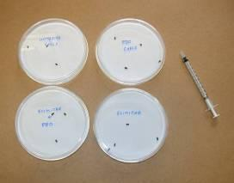
Resistance Management Strategies
7. Field monitoring of resistance:
By the time resistance obvious through failures, R frequency too high for implementation of effective and simple resistance management → more drastic changes required.
Petri dish test detects ABW resistance
Use multiple rates to determine resistance level
R. Cowles

Slide 67
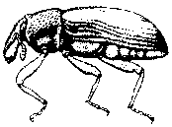
Resistance in ABW
On GCs with history of intensive insecticide use, particularly of pyrethroids
Resistance seems primarily based on increased enzymatic detoxification.
Continued intensive insecticide use
→ involvement of up to 3 detox. systems
→ up to 343x rate required to kill in lab tests !!!

Slide 68
Resistance in ABW
Increased detoxification particularly problematic because not very specific
→ Cross-resistance very common !!
→ In extreme cases most available AIs affected !!!
→MoA rotation no guarantee for resistance delay
Limited resistance to chlorpyrifos (up to 20x) already observed.

Slide 69
Baseline susceptibility
and cross resistance
Topical bioassay to determine LDs (≤ 72 h) for important AIs.

Slide 70
Topical Assay LD₅₀ / RR₅₀ @ 72 h (w/ technical grade AI)
Kostromytska et al. (2018a)
Number above bar: RR₅₀
Several other MoAs also affected, but lower RR₅₀s
Notes:
70

Slide 71
Greenhouse Assay LC₅₀ / RR₅₀ @ 72 h
RR₅₀s similar in greenhouse with formulated products
Kostromytska et al. (2018a)
Notes:
71

Slide 72
Field efficacy vs. ABW populations
with different resistance levels
Notes:
72

Slide 73
Field efficacy vs. ABW populations
with different levels of resistance
Insecticide class | AI | Trade name | Rate (lb ai/ac) | Targets
Pyrethroid | Bifenthrin | Talstar | 0.100 | Ad
Organo- phosphate | Chlorpyrifos | Dursban | 1.000 | Ad
 | Trichlorfon | Dylox | 6.000 | L3-4
Spinosyn | Spinosad | Conserve | 0.400 | Ad, L3-4
Oxadiazine | Indoxacarb | Provaunt | 0.225 | Ad, L3-4
Anthranilic diamide | Chlorantraniliprole | Acelepryn | 0.156 | L1-2, L3-4
 | Cyantraniliprole | Ference | 0.156 | L1-2, L3-4
Neonicotin. | Clothianidin | Arena | 0.247 | L1-2, L3-4
Koppenhöfer et al. (2018)
Notes:
73

Slide 74
ABW resistance level (x) and insecticide efficacy
343x 100x 30x 2x
Koppenhöfer et al. (2018)

Slide 75
Resistance - Recommendations
Reduce synthetic insecticide use.
Shift control measure more towards larvae.
RR₅₀ > 50: concentrate on larvae using Ference (L1-4), MatchPoint (L3-4), Provaunt (L3-4) (and Dylox [L3-4]).
RR₅₀ > 100: Ference (L1-4), Conserve/ MatchPoint (L3-4) (and Provaunt [L3-4]).
RR₅₀ > 100: rotate with biorationals!
Koppenhöfer et al. (2018)

Slide 76
Petri dish Validation Assay 9 cm dish, 1 filter paper 1 ml solution, 10 adults
24 h
Bifenthrin (Talstar)
48 h
PB susceptible
GB moderately resistant
EW, CN highly resistant
LI extremely resistant
72 h
Kostromytska et al. (2018b)
Notes:
same

Slide 77
Petri dish Validation Assay 9 cm dish, 1 filter paper 1 ml solution, 10 adults
24 h
Chlorpyrifos
48 h
PB susceptible
GB, EW, CN moderately resistant
LI highly resistant
72 h
Kostromytska et al. (2018)
Notes:
same

Slide 78
Resistance Level Assay -Conclusions
Petri dish assay easy option for ABW resistance detection and monitoring
Sufficient discriminating power
Easy to set up and conduct
One rate to separate susceptible and resistant population
Two rates to estimate resistance level

Slide 79
Don’t breed your own Super Weevil !!!
DON’T do repeated applications with the same insecticide class (e.g. pyrethroids, OPs).
DON’T exceed label rates.
DON’T do ‘wall-to-wall’ applications.
Spray as little as possible by practicing good Integrated Turf Management

Slide 80
ABW Biology and Control
Biology, ecology, damage
Monitoring
Insecticide resistance
Sustainable management:
non-resistant ABW
Sustainable management: resistant
Biorationals
Turning ABW into an ally

Slide 81
Most Successful Programs:
Include monitoring to make decisions
Minimize sprays – in time & space
Get good control of spring generation larvae
B. McGraw
Notes:
Shadow added for more contrast.

Slide 82
To Get Good Control… Monitoring is Essential !!
Forsythia still a good predictor
Start of migration (FULL BLOOM)
Peak densities = ½ Gold, ½ Green
Combine with insect counts
Soapy flushes, vac sampling, pitfall traps
B. McGraw
Notes:
…still a …
½ Gold, ½ Green
… traps

Slide 83
Ideal Timing of ABW Applications
(Timing for NY metropolitan area)
*Ad = adult; L1-3 = 1st – 3rd larval stage; L4-5 = 4th – 5th larval stage
Systemic Larvicides: Ference, Tetrino, Acelepryn, Suprado
Larvicides: MatchPoint, Provaunt, Dylox, Suprado
*Adulticides: Pyrethroids, chlorpyrifos, Provaunt
Koppenhöfer
et al. 2012
Notes:
83

Slide 84
Why 1st Generation Control is Important
Overwintering adults can lay many eggs over many weeks
Avg. 60 to 90 eggs/female
Over up to 15 weeks
Overlap in stages decrease effectiveness of controls
Larvae protected in stem
Pupae not susceptible
Notes:
Added ‘…not susceptible’ to last line.
You don’t seem to be making a strong case for controlling the spring generation.
Don’t the summer generations also lay a lot of eggs? And don’t the stages in the summer generations overlap even more?
Do you mean that ‘overlap of stages …’ in summer generations?
It would seem that the presence of 2-3 generation would be an important factor because (1) they could grow that much more if the earlier generations are not curbed and (2) the overlap in the summer generations is even worse in summer, making control even more challenging.
This

Slide 85
Does it make sense to apply adulticides before adult densities peak on playing surface?
NY: 3-year study:
Few adults feed on migration
Adults don’t lay eggs before peak densities reached
Our recommendation: Wait for peak adult densities!

Slide 86
Problems with pre-peak applications
unnecessary kill of beneficials
increased exposure of adult ABW to sublethal insecticide concentrations
less control
additional applications
faster resistance development !!
Notes:
I don’t mean that you should use this entire slide. But I think you should, in text or just orally, point out the problems with too early applications. The same applies more or less to overwintering site applications. There, insecticides are even less likely to work since the weevil are more difficult to reach with a (low-water solubility) contact AI and are not feeding so that AIs that need to be ingested don’t work, either.

Slide 87
Sustainable ABW Management
Most effective and sustainable option:
Work to reduce Poa as much as possible wherever possible.
Start on fairways.

Slide 88
Sustainable ABW Management
Minimize adult treatments
Concentrate on larvae
→ Allows more precise monitoring → more targeted treatments → less R selection
→ Softer on natural enemies → rebuild safety net of biological control → less R selection
Notes:
This should go here as it applies to resistant AND non-resistant populations.

Slide 89
Managing non-resistant ABW
while reducing risk for resistance development
Tailor applications to pest pressure.
You cannot eradicate ABW!
Excessive insecticide use may release ABW (and other pests) from suppression by natural enemies and can lead to resistant populations.
Don’t follow a ‘program’ blindly.
Monitor populations throughout season
Applications only when/where needed.

Slide 90
Risk assessment
Determine risk for ABW damage based on:
Percentage Poa annua in turf area
→ P. annua particularly susceptible
History of ABW problems
→ tend to show up in same areas.
Monitoring
→ base treatment decisions on observed larval and/or adult densities.

Slide 91
Insecticide
Efficacy vs. ABW*
DeltaGard (deltamethr.)
Tempo (cyfluthrin)
Talstar (bifenthrin)
Scimitar (λ-cyhalothr.)
Dursban (chlorpyrifos)
Dylox (trichlorfon)
Arena (clothianidin)
Merit (imidacloprid)
Suprado (novaluron)
Acelepryn
(chlorantraniliprole)
Ference (cyantranilipr.)
Tetrino (tetraniliprole)
MatchPoint (spinosad)
Provaunt (indoxacarb)
Aloft (clothia.+bifen.)
Allectus (imida.+bifen.)
*Non-resistant ABW only;
numbers inside bars are
number of trials in summary

Slide 92
ABW +/- preventive white grub management
If no preventive white grub (WG) management or if limited overlap in space → manage separately.
If large areas receiving preventive white grub treatments also at risk from ABW → coordinate management to reduce treatments.

Slide 93
Managing
non-resistant
ABW
1. ABW management only & low ABW risk:
- Monitor for larvae (full to late bloom Rhododendron).
- If significant densities → larvicide (MatchPoint, Provaunt, Dylox, Suprado)
Notes:
93
Need to specify that this is for populations that have not shown signs of resistance, yet. Where Acelepryn, Provaunt, Dylox still work.

Slide 94
Managing
non-resistant
ABW
2. ABW management only & higher ABW risk:
Monitor for adults (~1 week past forsythia ½ gold : ½ green ).
If significant densities → systemic larvicide (Ference, Tetrino, Suprado,(Acelepryn) (late bl. dogwood/eastern red bud).
In areas with particularly high risk, monitor for larvae and apply another larvicide if necessary.
Notes:
94

Slide 95
Managing
non-resistant
ABW
3. ABW & preventive WG management combined:
Apply systemic larvicide (Acelepryn, Tetrino) during full bloom dogwood)
Areas with very high ABW risk, monitor for larvae and, if necessary, apply another larvicide.
Rotate every ~3rd year: neonicotinoid* for WG → ABW separately.
*not in NJ
Notes:
95

Slide 96
Multi target - Key pest: ABW
Pest |  | Apr |  |  |  | May |  |  |  | June |  |  |  | July |  |  |  | Aug |  |  |  | Sept |  |  |  | Oct
ABW | Lv
 | Ad
 | Da
WG | Lv
 | Da
CB | Ny
 | Ad
 | Da
BCW | Lv
 | Da
SWW | Lv
 | Da
BB | Lv
 | Ad
 | Da
Acelepryn: ABW control @ 0.16 lb ai/ac
→up to 0.26 lb ai/ac for early and late applications
→also WG, SWW, BCW, BB control
→CB only suppression

Slide 97
Multi target - Key pest: ABW
Pest |  | Apr |  |  |  | May |  |  |  | June |  |  |  | July |  |  |  | Aug |  |  |  | Sept |  |  |  | Oct
ABW | Lv
 | Ad
 | Da
WG | Lv
 | Da
CB | Ny
 | Ad
 | Da
BCW | Lv
 | Da
SWW | Lv
 | Da
BB | Lv
 | Ad
 | Da
Tetrino: ABW control @ 0.045-0.09 lb ai/ac
→ 0.09 lb ai/ac for early and late applications
→ also CB, BCW, SWW, BB control
→ WG suppression (too early)

Slide 98
ABW Biology and Control
Biology, ecology, damage
Monitoring
Insecticide resistance
Sustainable management: non-resistant
Sustainable management:
resistant ABW
Biorationals
Turning ABW into an ally

Slide 99
ABW Resistance &
Insecticide Efficacy
Ference not affected by resistance.
Tetrino, Suprado, MatchPoint may be effective vs. resistant ABW but more data needed.
*Numbers inside bars are
number of trials in summary

Slide 100
Managing resistant ABW
Chlorpyrifos less effective than pyrethroids vs. adults!!!
Depending on degree of resistance, only effective compounds: MatchPoint, Ference, Suprado, (Tetrino) vs. larvae (≥ 80% control).
BUT: overuse likely to lead to resistance, too!!!
If you see something clearly not working: stop wasting time and money on it !!!
NO MORE PYRETHROIDS !!!

Slide 101
Managing resistant ABW – Strategy
1st year spring: systemic larvicide to all playing surfaces with ABW damage history.
→ Ference, Suprado (or Tetrino) late bloom dogwood to late bloom rhododendron.
MatchPoint full to late bloom rhodo.
Water in with 0.1”.
During summer apply only if high larval densities or onset of damage (monitor!!!)
Rotate MoAs

Slide 102
Managing resistant ABW – Strategy
In following years, start reducing applications.
Base treatments on monitoring.
Start reducing treatments on fairways
Then work your way up to higher profile areas.
Rotate MatchPoint, Ference, Suprado, (Tetrino) w/ Provaunt (test if still effective).
In areas with moderate larval densities (< 70/ft²) rotate with biorationals.
Notes:
We need to give them an outlook beyond going broke on Conserve.

Slide 103
How late do larvicides work? Why apply later?
Acelepryn, Ference efficacy: similar from late bloom dogwood (L1.0) to onset of full bloom rhododendron (L2.5)
Assessment of damage potential becomes easier and more precise later.
Late applications, if effective, cover a greater part of the population
Sometimes infestations are missed until larvae large.
L_{avg} = [nL₁×1 + nL₂×2 + nL₃×3 + nL₄×4 + nL₅×5 + nPu×6 + nTA×7]/N

Slide 104
ABW larval stage average on insecticide efficacy – Field (2 years)
L2.5: onset full bloom Rhododendron
L3.2: ~ 1 wk into full bloom Rhododendron
L4.0: just past bloom; ~ 2 wk after beginning

Slide 105
ABW larval stage average on insecticide efficacy – Field (2 years)
MatchPoint: L2.5 and L3.2 ≥ L4.0
Ference, Provaunt: L2.5 and L3.2 > L4.0
Dylox: L2.5 < L.3.2 > L4.0

Slide 106
Timing- Summary / Recommendations
Ference, Acelepryn: L1.0 = L2.5.
Ference, MatchPoint, Provaunt: L2.5 = L3.2
Dylox: L3.2 > L2.5
L4.0 generally lower but MatchPoint best
Concentrate on larvae
Assess damage potential at start of or during full bloom rhododendron
If necessary, apply asap
→ Less applications, less resistance development

Slide 107
ABW Biology and Control
Biology, ecology, damage
Monitoring
Insecticide resistance
Sustainable management: non-resistant
Sustainable management: resistant
Biorationals
Turning ABW into an ally

Slide 108
Entomopathogenic nematodes (EPN)
obligate lethal parasites of insects
mutualistic association with bacteria
> 26 Heterorhabditis & 100 Steinernema spp.
host searching capacity
host range +/- broad
ease of production
recycling capacity
Infective juvenile nematodes
Notes:
108
Before I show some data, I will briefly characterize the organisms involved in this study.
EPN are obligate lethal parasites of insects that quickly kill their host with the help of symbiotic bacteria. The host range under field conditions varies with sp., some spp. being rather opportunistic, other spp. specialized to one type of host.
EPN possess host searching capacities, are easily mass-produced, and have the capacity to recycle in their hosts, thus increasing efficacy and persistence.

Slide 109
Entomopathogenic nematode life cycle

Slide 110
H. bacteriophora + P. luminescens
S. carpocapsae + X. nematophila
EPN Infections – cadaver color caused by symbiotic bacteria
H. bacteriophora
EPNs visible
through cuticle
S. scarabaei +
X. koppenhoeferi
H. bacteriophora
grub cuticle removed

Slide 111
Nematode products for US turf market
Nematode | Targets¹ | Product (Producer)
Steinernema carpocapsae | BCW, SWW, AW, BB, Fleas | Millenium (BASF), Capsanem (Koppert), Ecomask (BioLogic)
Heterorhabditis bacteriophora | WG, BB | Nemasys G (BASF), Terranem NAm (Koppert), Heteromask (BioLogic)
¹BCW = black cutworm; SWW = sod webworm; AW = armyworm
BB = billbugs; WG = white grubs; MC = mole crickets
Notes:
I will start with a short introduction with background information about IPM, WGs, and biological control.
This will be followed by 3 examples for interaction between WG control agents.
Then I will explain the mechanism of interaction between 2 of these agents,
and conclude with an outlook on my research.

Slide 112
EPN vs. ABW larvae
- Fairway trials
vs. spring gen. L3-L5
1.0 bill. IJs/acre
Sc most consistent suppression (~65%)
McGraw et al. (2010)
Notes:
112

Slide 113
EPN + Merit - Field 2014
Merit: 0.3 lb ai/acre; EPN: 0.5 or 1.0 bill. IJs/acre
Koppenhöfer
et al. (2020)
Split application improves S. carpocapsae
Additive Merit-EPN interaction
Merit + split Sc → excellent control
Merit simultaneously controls white grubs
Notes:
4
Why do we want to combine EPN with other agents? EPN on their own can provide good white grub control but their performance is not always consistent and can generally be improved. By combining EPN with other control agents, we hope to improve the efficiency of EPN, and also achieve more consistent results. The overall goal of these combination studies is to develop control approaches that are competitive and contribute to reducing the use of chemical pesticides.

Slide 114
EPN vs. ABW
Steinernema carpocapsae or
Heterorhabditis bacteriophora.
Apply when larvae start to appear in soil.
If soil dry and/or hot, ~0.1” irrigation before application.
~0.25” post-treatment irrigation.
Keep soil moderately moist at least 1 wk.
Split application tend to improve efficacy.
Notes:
I will start with a short introduction with background information about IPM, WGs, and biological control.
This will be followed by 3 examples for interaction between WG control agents.
Then I will explain the mechanism of interaction between 2 of these agents,
and conclude with an outlook on my research.

Slide 115
Chromobacterium subtsugae
GRANDEVO® CG ! - 30% ai
C. subtsugae strain PRAA4-1 and spent fermentation media
2-4 lbs/ac f. surface feeders
10-20 lbs/ac f. white grubs
OMRI approved
Activity vs. white grubs (varies with species), chinch bugs, billbugs, sod webworms.
Notes:
- The Buibui strain of Btj is a facultative pathogen and can be easily mass produced.
- It is scarab-specific, and
- highly toxic to young G.
- Btj works like other Bt strains. Its vegetative cells produce a spore and a toxin crystallized in the parasporal body. When ingested by a susceptible host, the toxin binds to the midgut epithelium and causes a disruption of the cell permeability, that results in lysis of the cell and ultimately causes a septicemia.

Slide 116
Burkholderia spp.
VENERATE® XC ! – 94.46% ai
Burkholderia spp. strain A396 cells and spent fermentation media
For fruit and vegetables
Turfgrass not on label yet
OMRI approved
Activity vs. caterpillars and billbugs
Notes:
- The Buibui strain of Btj is a facultative pathogen and can be easily mass produced.
- It is scarab-specific, and
- highly toxic to young G.
- Btj works like other Bt strains. Its vegetative cells produce a spore and a toxin crystallized in the parasporal body. When ingested by a susceptible host, the toxin binds to the midgut epithelium and causes a disruption of the cell permeability, that results in lysis of the cell and ultimately causes a septicemia.

Slide 117
Azadirachtin
Molt-x® – 3.0% ai
Azadirachtin, botanical extract from neem tree
8-10 (max. 22.5) fl oz/ac
OMRI approved
Activity vs. numerous insects incl. weevils
Notes:
- The Buibui strain of Btj is a facultative pathogen and can be easily mass produced.
- It is scarab-specific, and
- highly toxic to young G.
- Btj works like other Bt strains. Its vegetative cells produce a spore and a toxin crystallized in the parasporal body. When ingested by a susceptible host, the toxin binds to the midgut epithelium and causes a disruption of the cell permeability, that results in lysis of the cell and ultimately causes a septicemia.

Slide 118
Field Efficacy
vs. ABW
Adults
susceptible (2x)
resistant (55x)
Grandevo
2x 4-8 lbs/ac
Venerate
2x 8-16 pt/ac
Notes:
118

Slide 119
Field Efficacy
vs. ABW
Larvae
susceptible (2x)
resistant (55x)
Molt-X
2x 1.4 pt/ac
Grandevo
2x 4-8 lbs/ac
Venerate
2x 8-16 pt/ac
Notes:
119

Slide 120
Civitas Turf Defense
a.i. Mineral oil (88.8%)
Primarily fungicide, also insects on label
Insects rec. 8.5 - 17 fl.oz. in 1.5 gal/1,000 ft²
Greenhouse: best if soil saturated, 2-4 gal/1000 ft² spray volume, 0.05-0.1” post-spray irrigation.
Field results highly variable: 13-55% control. Probably best if 17 floz at peak adults or 2x 8.5 floz ~7 days apart around peak adults.
Not affected by resistance
Notes:
- The Buibui strain of Btj is a facultative pathogen and can be easily mass produced.
- It is scarab-specific, and
- highly toxic to young G.
- Btj works like other Bt strains. Its vegetative cells produce a spore and a toxin crystallized in the parasporal body. When ingested by a susceptible host, the toxin binds to the midgut epithelium and causes a disruption of the cell permeability, that results in lysis of the cell and ultimately causes a septicemia.

Slide 121
Entomopathogenic Fungi
facultative lethal parasites of insects
Beauveria & Metarhizium species
host range +/- broad; many different strains
before spore germination after
Metarhizium sp. (white grub)
Beauveria sp.
(chinch bug)

Slide 122
F52 conidia-based
liquid formulation
Met 52 EC
11% a.i, 89% petroleum distillates
~5.5×10⁹ CFU g⁻¹
Rec. field rates: 6.4-9.6 kg ha⁻¹
Field rates: 9.6-19.2 kg ha⁻¹
→ ~5-10×10¹³ CFU ha⁻¹

Slide 123
Spring 2019 - field test
Mscl (50 kg/ha), imi (336 g ai/ha), Con-l / Con-h (9.6 / 19.2 kg/ha)
Microsclerotia (Mscl): ineffective
Imidacloprid (imi): low efficacy
Conidia (Con): low efficacy
Microsclerotia & Conidia + imi: additive mortality
Notes:
123

Slide 124
ABW Biology and Control
REMEMBER
Intensive insecticide use is very likely to lead to ABW resistance.
Getting on the pesticide treadmill with ABW is a 1-way road that over time gets ever uglier and harder to leave.
The sooner you leave the better !
Best not to get there in the first place !

Slide 125
ABW Biology and Control
Biology, ecology, damage
Monitoring
Insecticide resistance
Sustainable management: non-resistant
Sustainable management: resistant
Biorationals
Turning ABW into an ally

Slide 126
Outlook: Turning ABW into an ally
In mixed bentgrass-Poa annua fairways
Monthly applications of low rate paclobutrazol (6-12 fl oz/acre) combined with ABW larvicides only when needed (threshold) dramatically reduce Poa annua with limited and short time negative effects on turf quality.
→ Ongoing research: at what Poa levels can ABW alone suppress Poa?

Slide 127
ABW+Paclo vs Poa - % Poa reduction in 1 year
Paclobutrazol (fl oz/A) | + ABWcide Preventive | + ABWcide Threshold | + No ABWcides
0 | --- | 28 (20-37) | 44 (32-56)
4 | 47 (33-61) | 70 (57-83) | 70 (56-79)
6 | 55 (46-63) | 82 (72-92) | 82 (77-87)
12 | 88 (84-93) | 78 (68-87) | 88 (87-90)
High rate of Paclo most effective
½ rate Paclo with Threshold or No-Insecticides similar
1/3 rate Paclo w/ Threshold or No-Insecticides quite effective

Slide 128
My Rutgers Entomology Webpage:
http://entomology.rutgers.edu/personnel/albrecht-koppenhofer/
Extension presentations
Extension publications

Slide 129
Acknowledgments
Funding:
Rutgers Ctr f. Turfgrass Sci.,
GCSAA + chapters, NJTA, NYSTA,
OJ Noer, Tri-State, USGA, USDA-NIFA

